Slide 1
Hiding A Text Inside An Image Using Stenography

Slide 2
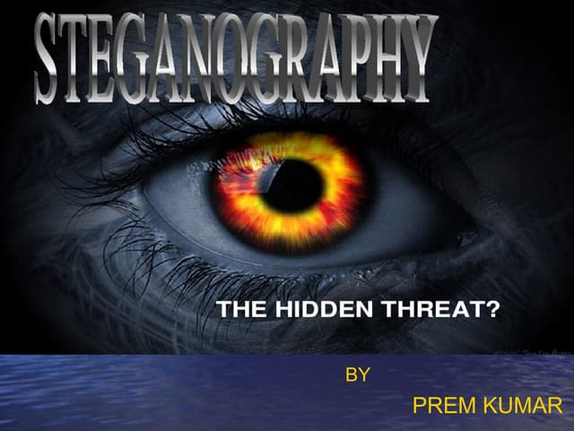
Introduction to Image Steganography.
Image steganography is the practice of hiding messages or information within an image.
It is a form of secret communication that conceals the existence of the message.
Steganography techniques can be used to embed text, images, audio, or video within another file.
Notes:
Image source: https://forensicsdigest.com/steganography-in-digital-forensics/

Slide 3
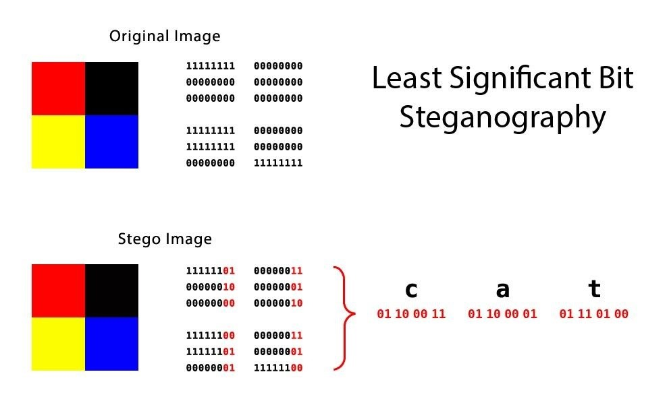
How Does Image Steganography Work?
In image steganography, the secret message is embedded within the image data itself.
This can be achieved by altering the pixel values of the image or by manipulating the color channels.
The changes made to the image data are usually subtle and not easily detectable by the human eye.
Notes:
Image source: https://www.indianwebs.in/2018/09/steganography.html

Slide 4
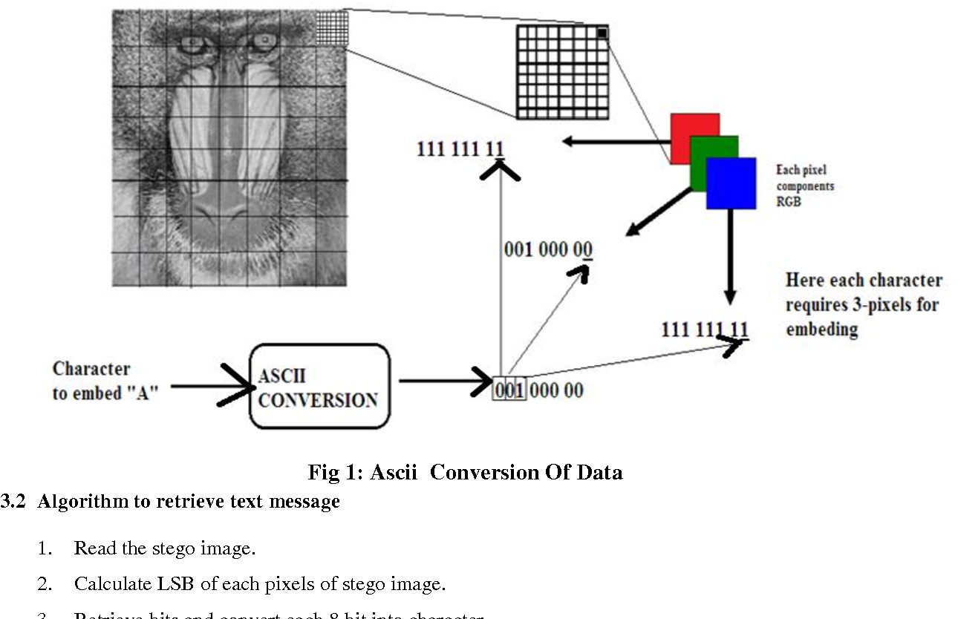
Common Methods of Image Steganography.
Least Significant Bit (LSB) insertion is a popular method where the message bits are inserted into the least significant bit of the image pixels.
Spatial domain techniques hide the message by subtly altering the spatial characteristics of the image.
Transform domain techniques involve transforming the image data using mathematical functions before embedding the message.
Notes:
Image source: https://www.semanticscholar.org/paper/Least-Significant-Bit-(-LSB-)-and-Discrete-Cosine-(-Gouda/e3a33526121cceab9add6b1a68065be3a4b73b28/figure/0

Slide 5
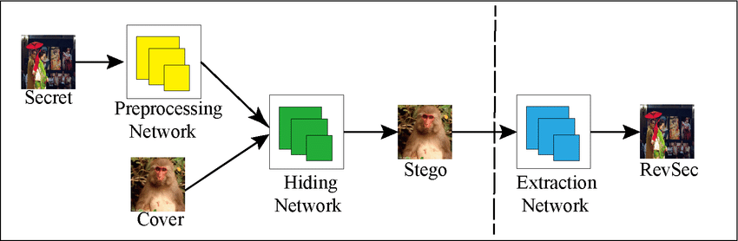
Advantages of Using Image Steganography.
Image steganography provides a high level of security as the hidden message is not easily detectable.
It can be used to securely transmit sensitive information without raising suspicion.
Steganography can be applied to digital watermarking, copyright protection, and authentication.
Notes:
Image source: https://www.skillrary.com/blogs/read/steganography-hidden-threat

Slide 6
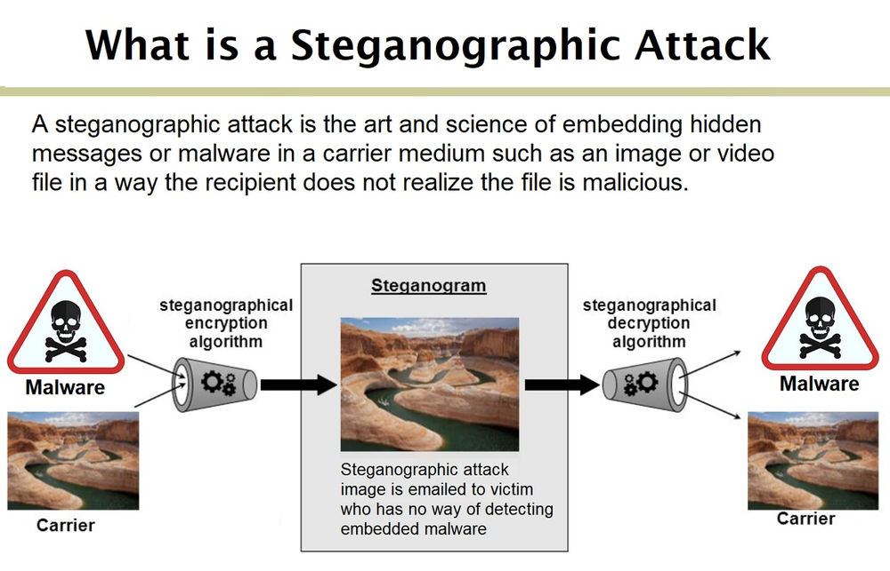
Risks and Challenges of Image Steganography.
One of the main challenges of image steganography is maintaining the quality of the cover image.
Detection of steganographic content by advanced algorithms poses a risk to the security of the hidden message.
Steganography can be misused for malicious purposes such as hiding malware or illegal content.
Notes:
Image source: https://www.researchgate.net/publication/333320046_Steganography_Security_Challenges_and_Defense

Slide 7

Steps to Hide a Text Inside an Image Using Steganography.
Select a cover image that will be used to hide the text message.
Choose a steganography tool or software to embed the text into the image.
Adjust the embedding parameters and encryption settings for added security.
Notes:
Image source: https://www.youtube.com/watch?v=8uufmw-blQc

Slide 8

Step 1: Selecting a Cover Image.
The cover image should be of high quality to ensure a seamless integration of the hidden text.
Avoid using images with complex patterns or textures that may make the hidden message more visible.
Consider the size and format of the cover image to accommodate the embedded text.
Notes:
Image source: https://www.pinterest.com/pin/334321972338913812/

Slide 9
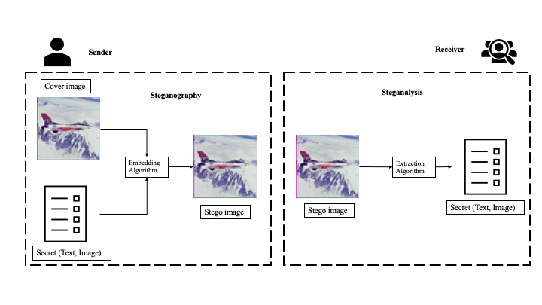
Step 2: Choosing a Steganography Tool.
Research and select a steganography tool that suits your requirements and level of expertise.
Ensure the tool supports the desired embedding method and provides encryption options for secure communication.
Familiarize yourself with the tool's interface and functionalities before proceeding with the embedding process.
Notes:
Image source: https://www.researchgate.net/figure/A-block-diagram-of-information-hiding-and-steganography-process_fig10_237066020

Slide 10
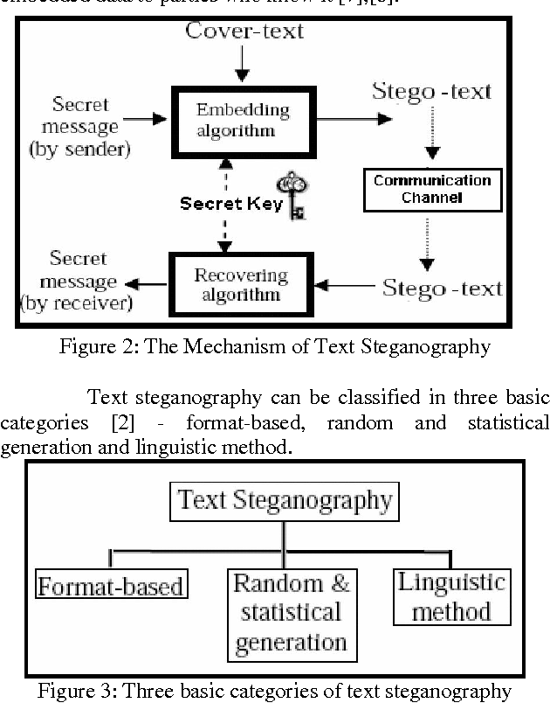
Step 3: Embedding the Text Message.
Open the selected cover image within the steganography tool.
Input the text message that you want to hide within the image.
Follow the tool's instructions to embed the text message using the chosen steganography technique.
Notes:
Image source: https://www.semanticscholar.org/paper/Novel-Text-Steganography-through-Special-Code-Banerjee-Bhattacharyya/7476865d8824b81640639aadd6ac737c47b8c5a3/figure/0

Slide 11
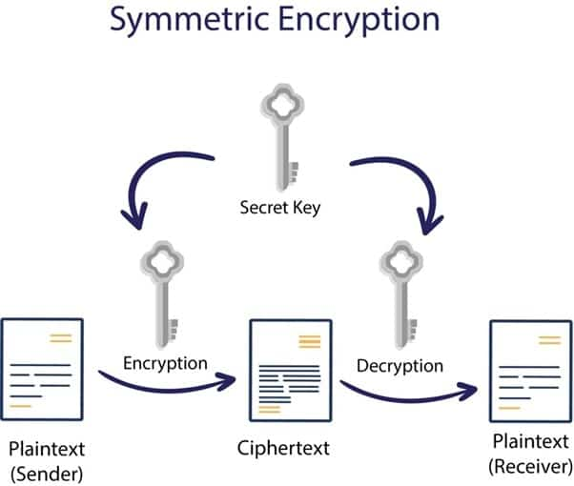
Ensuring Security and Anonymity in Image Steganography.
Use strong encryption algorithms to protect the hidden message from unauthorized access.
Consider using password protection or key-based encryption for added security.
Be cautious when sharing steganographic images to prevent unintended disclosure of the hidden information.
Notes:
Image source: https://www.encryptionconsulting.com/comparison-of-various-encryption-algorithms-and-techniques-for-securing-data/

Slide 12
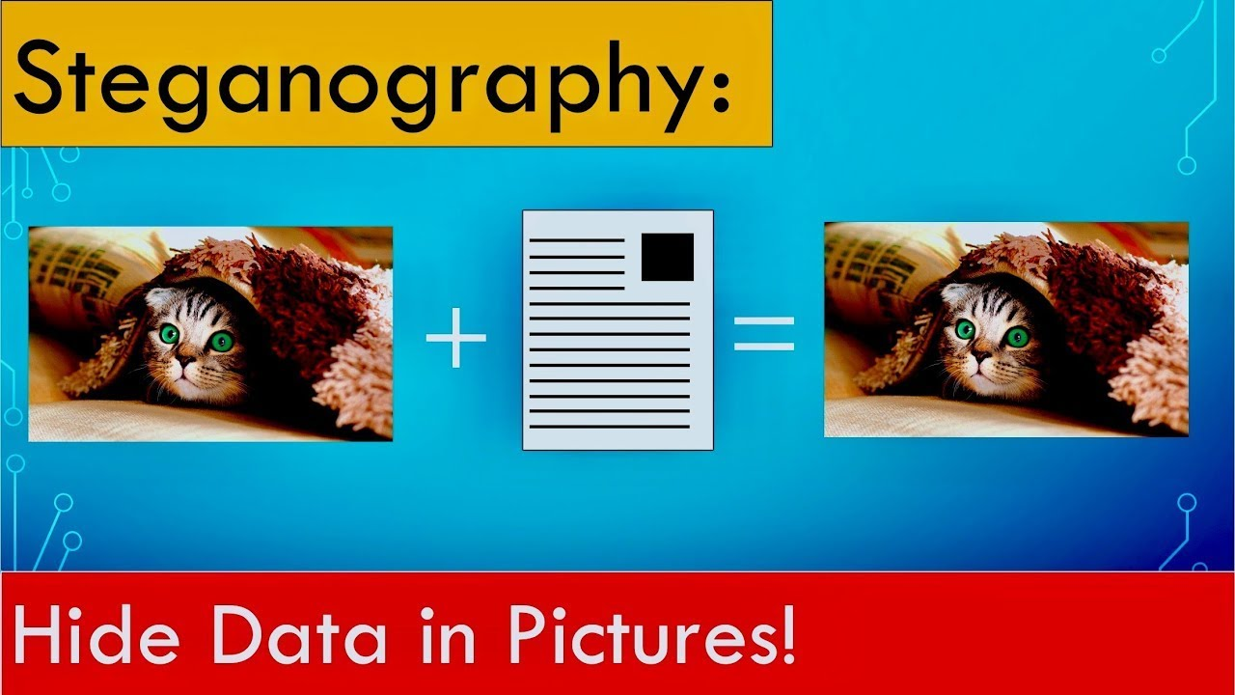
Detecting and Extracting Hidden Text from an Image.
To extract the hidden text from an image, use the same steganography tool that was used for embedding.
Input the steganographic image into the tool and follow the extraction process to reveal the hidden text.
Ensure that the extracted text is accurate and intact before sharing or using it.
Notes:
Image source: https://www.youtube.com/watch?v=WmaXrJoKYyc

Slide 13
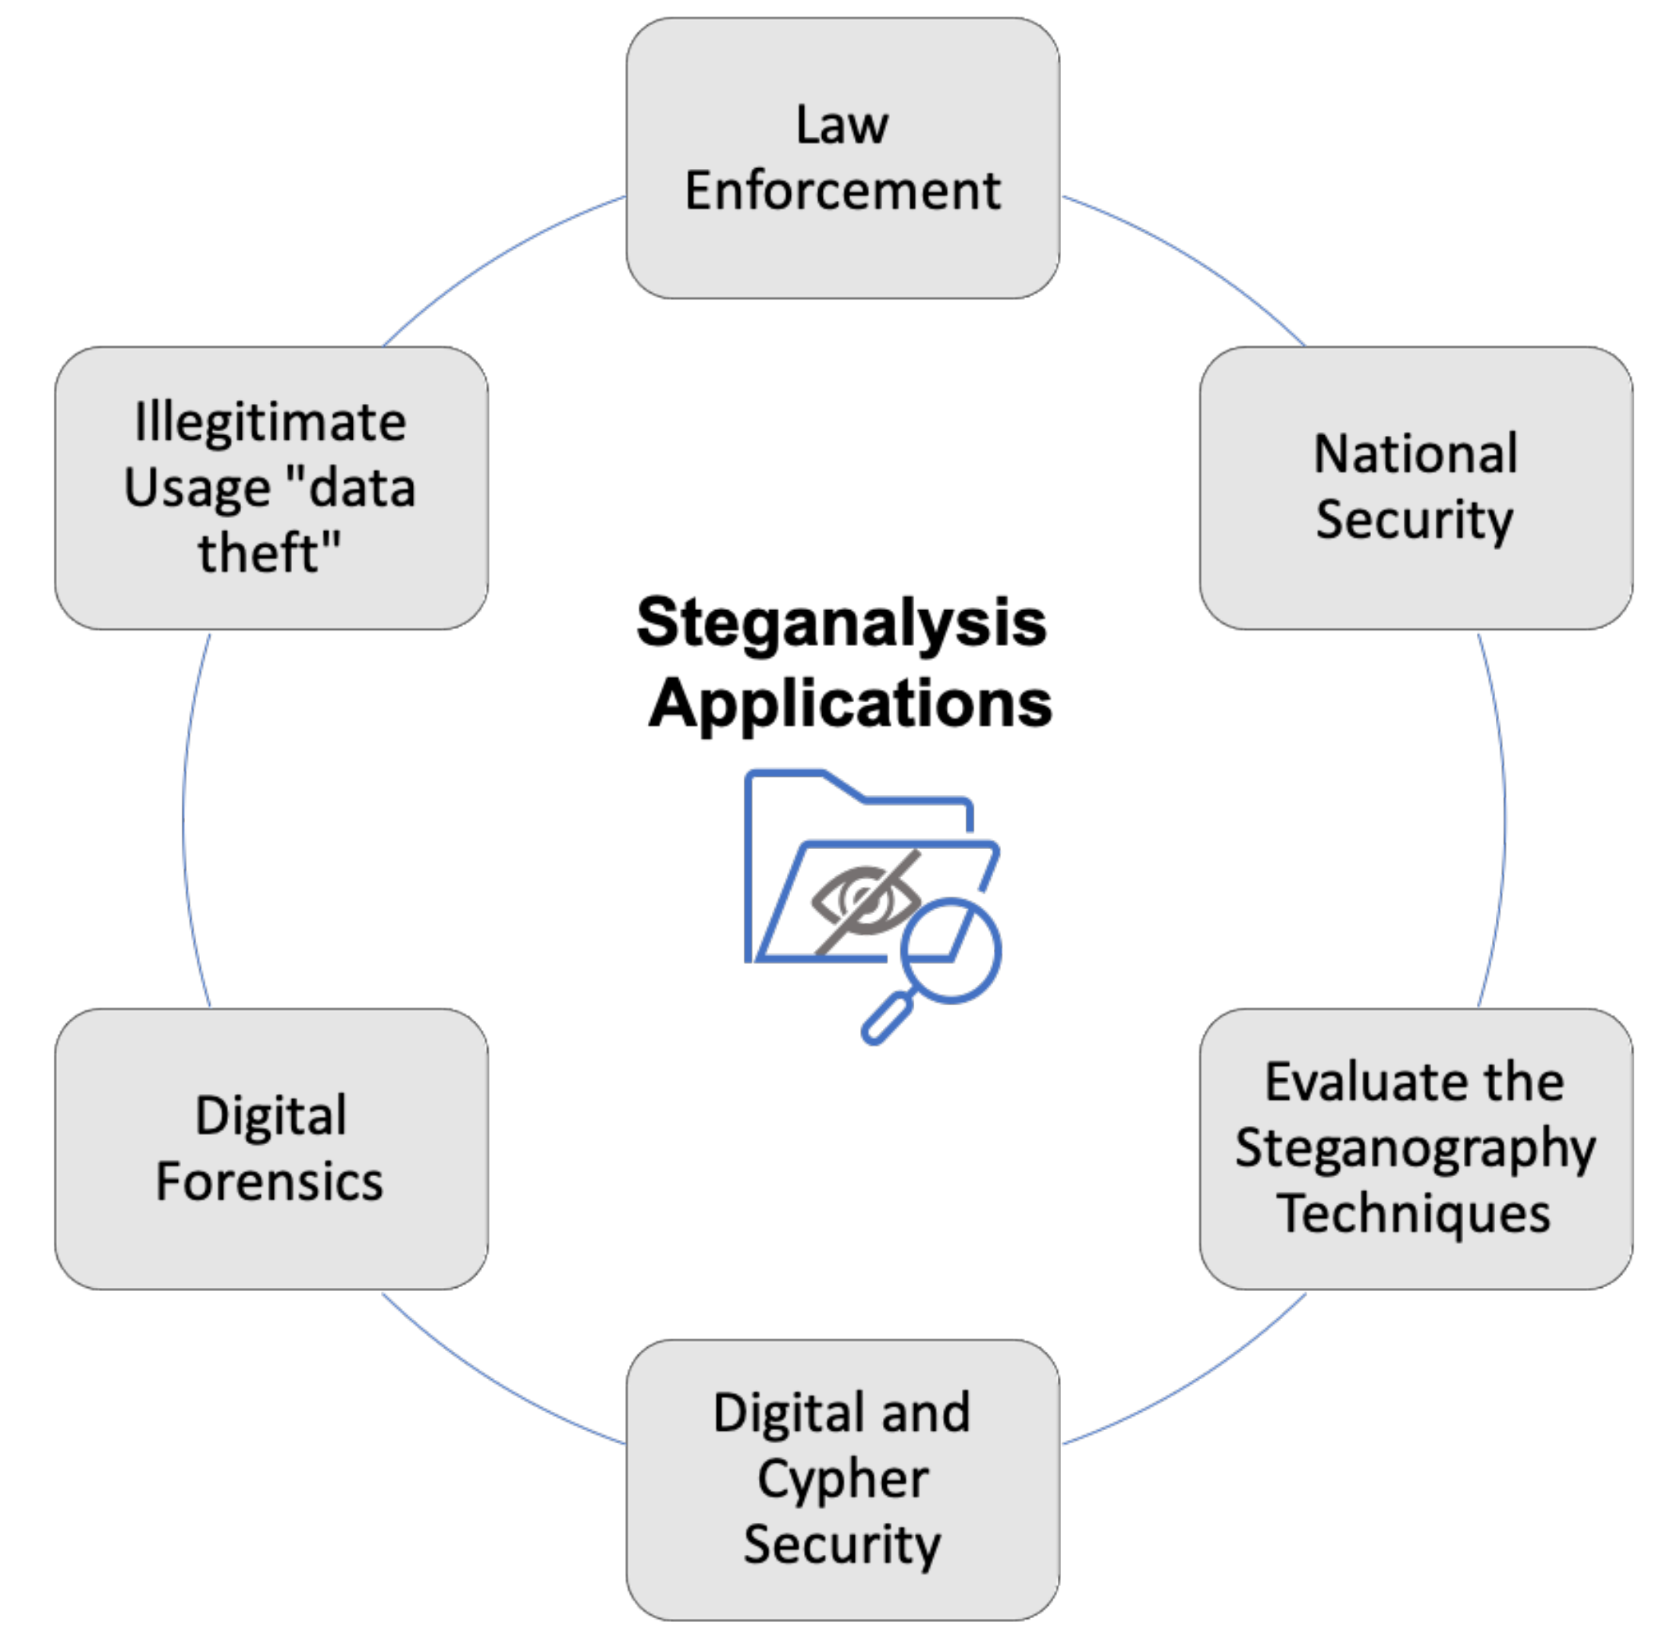
Ethical Considerations in Image Steganography.
Ensure that the use of image steganography complies with ethical standards and legal regulations.
Respect the privacy and confidentiality of individuals when embedding or extracting hidden messages.
Use steganography responsibly and avoid using it for illicit or harmful purposes.
Notes:
Image source: https://www.mdpi.com/2073-8994/14/1/117/htm

Slide 14
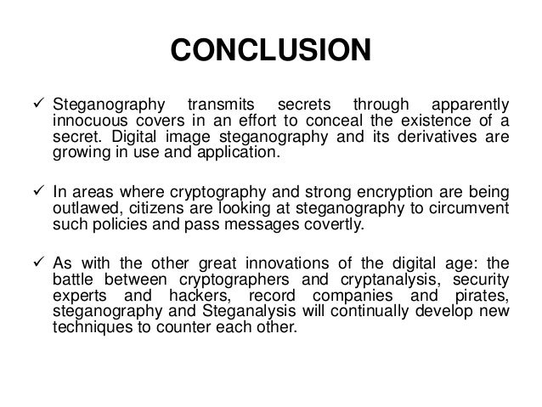
Conclusion - Advantages and Applications of Image Steganography.
Image steganography offers a secure and covert means of communication for various applications.
It can be used in digital forensics, data hiding, secure communication, and copyright protection.
By understanding the principles of steganography, individuals can leverage its benefits while being mindful of potential risks.
Notes:
Image source: http://es.slideshare.net/BSheghembe/steganography-presentation-47951802

Slide 15
Thank you

